Slide 1
Examining Resultant Policies Arising from Different Action Spaces
Luke Ritchie

Slide 2

Overview
What?
Why?
How?

Slide 3
Related Work
Little comparison of same agent on different action spaces
Representing large action spaces: https://people.cs.umass.edu/~pthomas/papers/Chandak2019.pdf
Some discussion of variable action spaces
Action eliminators: https://papers.nips.cc/paper/7615-learn-what-not-to-learn-action-elimination-with-deep-reinforcement-learning.pdf

Slide 4

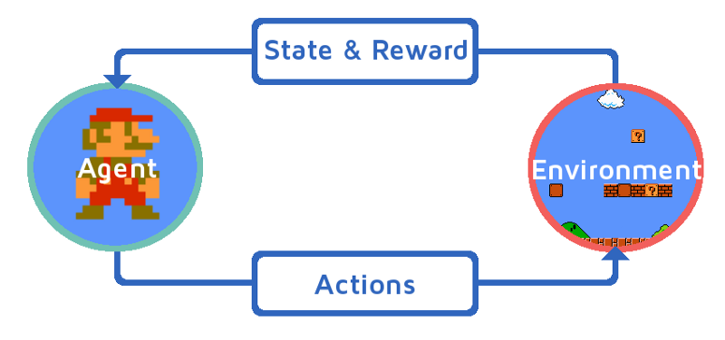
The Problem
First, some context:

Slide 5
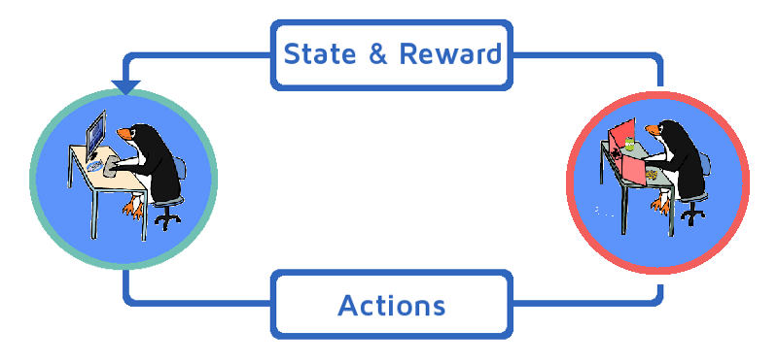
The Problem
Similar form, however planning is hard
Planning
Playing

Slide 6
The Plan
Reduce planning uncertainty by simulating player combat
Bonuses:
Environment is well defined
Can be modeled using RL

Slide 7
The Plan
Approach:
Create environment simulating combat
Create two unique action spaces
Create REINFORCE Agent to train
Compare Policies

Slide 8
The Plan
The Environment:
Single enemy with one goal
Confined space
Enemy information
Rewarded for health totals

Slide 9


The Plan
The actions:
Each space has a set of actions in common
Each space has a different set of distributions
Each space has a handful of unique actions
  Ranged, Melee

Slide 10
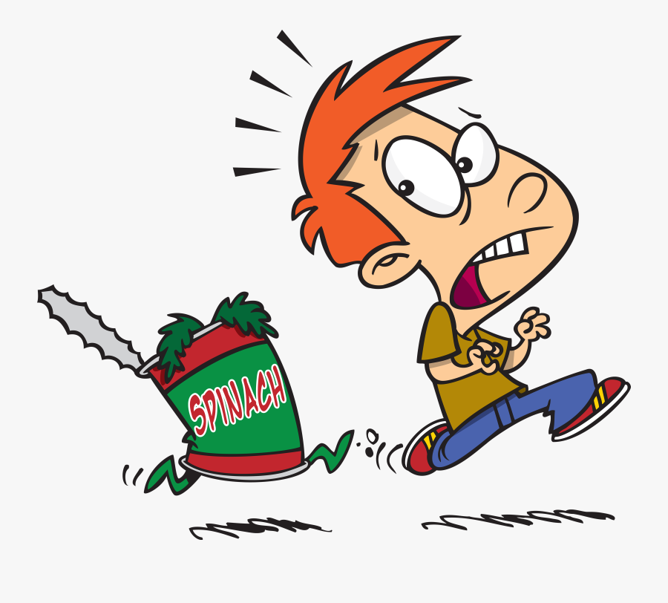

Predictions
Ranged
Strafe, attack
Melee
Charge, attack

Slide 11
Implementation Choices
Observation Space
  Agent Location
  Distance to enemy
  Enemy Damaged T/F
  Agent Health
  Available Actions
Agent is penalized for illegal moves
Agent goes first

Slide 12
So Far
Environment completed
REINFORCE 90% Implemented
Environment + REINFORCE in progress

Slide 13
Next Steps
Increase complexity
  More actions
  Multi-agent
Increase breadth
  Different types
  Different enemies

Slide 14
Questions?

Slide 15
Image Sources
https://www.dailydot.com/parsec/dungeons-and-doggos/
https://publicdomainvectors.org/en/free-clipart/Penguin-dungeon-master/79340.html
https://www.freecodecamp.org/news/a-brief-introduction-to-reinforcement-learning-7799af5840db/
https://www.iconfinder.com/icons/1898271/20d_d20_dd_dice_dragons_dungeons_icosahedron_icon
http://clipart-library.com/images-of-bow-and-arrow.html
http://www.clker.com/clipart-black-sword-2.html

